Slide 1
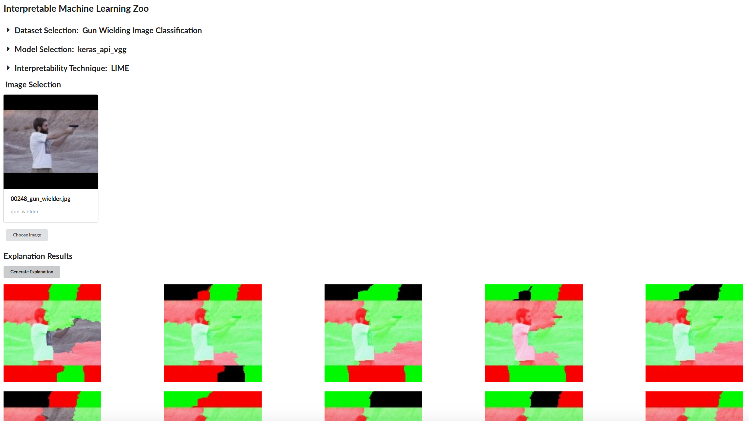
Interpretability Framework - Motivation
Brings together existing (and new) interpretability techniques alongside datasets and machine learning models.
Simplifies experimentation and data generation.
Allows the sharing and testing of ideas across the research team reducing repeated work and setup time.
Engage with the wider community through open-sourcing the framework.

Slide 2
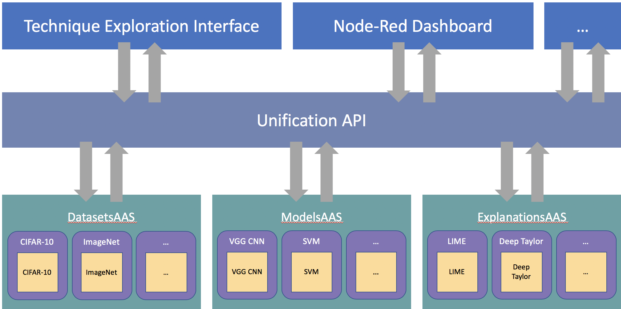
Interpretability Framework - Architecture
Interface Layer Decoupled user interfaces.
Unification Layer API offering easy access to framework items.
Service Layer Services for each category coordinate instantiation and data passing.
Class & Implementations Layer Classes wrap around implementations of items maximizing interconnectivity.

Slide 3
Interpretability Framework - Example Use Cases
Compare the outputs of multiple interpretability techniques when processing the same model and input to evaluate their strengths & weaknesses.
Compare multiple outputs generated by a single interpretability technique for the same input to evaluate the technique’s stability.
Compare outputs from a single interpretability technique when using different models (e.g. architecture, training, algorithm) to evaluate how the technique’s effectiveness depends on the model.

Slide 4


Interpretability Framework – Current & Future Work
Comparative/sensitivity analyses of explanation techniques - we demonstrated the debugging process of generating multiple explanations from the same technique to measure and improve its stability.
Empirical studies of explanation visualisations – exploration of the effect the choices made for visualising explanation data can effect it’s utility.
Eliciting stakeholder requirements for application-level interpretability – engaging with subject-matter experts to gain insights as to what constitutes a useful explanation for aiding task performance.

Slide 5
Interpretability Framework – Included Items (so far)
Datasets
Gun Wielder Classification
Traffic Congestion
CIFAR-10
MNIST
ImageNet
Models
Neural Networks Architectures:
VGG16
VGG19
InceptionV3
Inception ResNet V2
MobileNet
Xception
Other Models:
Support Vector Machine
Explanation Techniques
LIME
Shapely
Deep Taylor LRP
Influence Functions

